Slide 1
The Economics of Taxation and Dynamic Scoring: Theory and Evidence for Tax Policy Evaluation
John A. Spry, Ph.D.
Associate Professor
Opus College of Business
University of St. Thomas
jaspry@stthomas.edu
The views expressed herein are solely those of the author and do not represent the views of the State of Minnesota or the University of St. Thomas. All errors are my own.

Slide 2
High Effective Marginal Tax Rates
The “effective marginal tax rate” is an economic term for the fraction of an additional dollar earned that is lost to taxation.
Many Minnesotans face effective marginal tax rates that approach and even exceed 100 percent because of compounded taxes on top of other taxes and a mish-mash of social service programs.
A Minnesota House Research study found that -given the intersection of our tax system with various social programs- the average effective marginal tax rate for a single parent with two children and income between $23,500 and $41,700 was 104%. (Wilson and Hirasuna, Proceedings of the National Tax Association, 2004.)
On average, working overtime to earn an additional $1,000 in gross income reduces household after-tax income by $40 in this income range.
Notes:
Sources:
Paul Wilson and Donald Hirasuna, “Effective Tax Rates Facing Minnesota’s Low- and Moderate- Income Workers: The Impact of Budget Cuts on Incentives,” Proceedings of the 2004 National Tax Association Annual Conference on Taxation: 325-
35.
Also in State Tax Notes (May 16, 2005): 507-515.
http://www.taxadmin.org/fta/meet/06re_data/pres/Wilson_low-income.pdf
How a mish-mash of social programs and tax provisions punishes hard work
Example: Single parents with modest incomes in Minnesota can face ‘effective marginal tax rates’ over 100%
By John Spry
St. Paul Pioneer Press (MN) – Sunday May 9, 2010 – Page B9
Are we still a society that values honest work?
Our state and federal laws provide an unpleasant answer. Our tax code imposes punishing tax rates on work. Working more to increase pre-tax income can actually reduce a family’s take home pay.
The “effective marginal tax rate” is a technical term for the fraction of an additional dollar earned that is lost to taxation. It is a measure of the bite that taxes take out of your paycheck when you work a little more.
Too many Minnesotans face effective marginal tax rates that approach and even exceed 100 percent because of compounded taxes on top of other taxes and a mish-mash of social service programs.
High marginal tax rates create a disincentive to earn by reducing the rewards for work. Over time, these high effective tax rates debase our culture by undermining the virtue of hard work.
How can working more actually reduce take-home family income?
There are at least 16 federal and state programs in Minnesota to transfer cash and non-cash benefits to households with low or moderate incomes. Each of these programs has its phase-outs that “claw back” benefits as these households work more and increase their pre-tax income.
Phase-outs increase effective marginal tax rates. So the cumulative effect of households facing several program and tax phase-outs simultaneously can create what effectively is a tax rate of over 100 percent on additional income.
A study by the non-partisan Minnesota Taxpayers Association (MTA) provides a concrete example. Consider a single parent of two children who works more to increase gross family income from $33,000 to $34,000. The effective marginal tax rate from the federal and state earned-income tax credit phase-outs are about 21 percent and 10.3 percent, respectively. These rates reduce the family’s tax credits — in effect, its income — by about $210 and $103. In addition, benefits from the Basic Sliding Fee child-care program are reduced by $1,692 because of the sliding fee.
Thus, the reward for earning an additional $1,000 in gross wages is a reduction in take-home family income of $1,005 because of the combined effects of these three programs.
High tax rates are unfair to people seeking to help their family by working harder. A Minnesota House Research study found that — given the intersection of our tax system with various social programs — the average effective marginal tax rate for a single parent with two children and income between $23,500 and $41,700 was 104 percent. On average, working overtime to earn an additional $1,000 in gross income reduces household after-tax income by $40.
These programs and the tax code were created over time by different committees in St. Paul and Washington, D.C. There was no attempt to measure the compound effect of different sections of the tax code and the phase-outs of various programs on the incentives of real people to work. These disincentives to work are a barrier to opportunity and social mobility because working more or getting a better paying job means higher tax payments instead of higher after-tax income.
A rededication of society to the simple principle that work should pay is the start of a solution to the disincentive-to-work problem.
If society values work, then we should reward work by reducing effective marginal tax rates. This will require tax reform to broaden tax bases by ending tax loopholes while lowering tax rates. It also will require an overhaul of our social service programs. We need to examine Minnesota’s social programs as a whole system. A redesign of social programs could lower effective marginal tax rates for everyone below 50 percent.
Everyone should benefit from their own hard work by keeping the fruit of their labor.
John Spry of St. Paul is an associate professor in department of finance at the University of St. Thomas.
Background on this subject can be found on the Web at: www.taxadmin.org/fta/meet/06re_data/pres/Wilson_low-income.pdf and at www.mntax.org/cpfr/disincentives.php

Slide 3
High Effective Marginal Tax Rates
The Governor’s and President’s budgets would raise Minnesota’s combined marginal income tax rate on working from 43% to 53.5%.
Federal rate hikes from 35% to 39.6%.
Minnesota rate hike from 7.85% to 10.95%.
3.8% Medicare tax (employee and employer) in 2013
Pease provision limits federal deductibility of Minnesota taxes.
The economic damage from raising tax rates from 43% to 53.5% is far greater than the 24% increase in tax rates. The economic inefficiency from this higher tax rate would be approximately 55% higher than the economic inefficiency from the current rate.
The marginal cost of public funds at the current 43% rate is around somewhere between $1.50 and $4.80 per additional dollar of tax revenue raised.
Notes:
The Governor’s and President’s budgets would raise Minnesota’s combined marginal income tax rate on working from 43% to 53.5% for workers in the highest tax brackets.

Slide 4
Higher Marginal Income Tax Rates Cause Economic Inefficiency Several Ways
A strong incentive to time taxable transactions to occur in years with lower tax rates.
A strong incentive to rearrange financial and accounting transactions to engage in the maximum legal tax avoidance.
A disincentive to supply additional hours of effort.
This affects female workers the most.
A disincentive to invest in education and on-the-job-training.
A disincentive to take risky, disagreeable jobs that receive a higher, compensating wage premium for less pleasant working conditions.
A strong incentive to take compensation in tax preferred forms (perks, exotic business trips, tax-free benefits, ect.)
A strong incentive to invest in lower-risk, tax free investments (Municipal bonds and Treasuries) instead of taxable equity in high-risk startups.

Slide 5
The Marginal Cost of Public Funds
The marginal cost of public funds measures the total cost to the economy of collecting one more dollar of tax revenue.
The deadweight loss or excess burden of a dollar of tax revenue measures the dollar value of all the bad decisions made because of taxation beyond the dollar of revenue collected.
The marginal cost of public funds is the sum of a dollar of revenue and the deadweight loss from an additional dollar of additional revenue.
Notes:
Source: http://www.whitehouse.gov/omb/circulars_a094/ , Item 11.
Deadweight loss and the marginal cost of public funds are economic terms that define how leaky the bucket is in the leaky bucket model of taxation.

Slide 6
The Marginal Cost of Public Funds
“Because taxes generally distort relative prices, they impose a burden in excess of the revenues they raise. Recent studies of the U.S. tax system suggest a range of values for the marginal excess burden, of which a reasonable estimate is 25 cents per dollar of revenue.” -The Obama Administration’s OMB
This means on average $1.00 in federal tax revenue costs the economy $1.25.
Notes:
Source: http://www.whitehouse.gov/omb/circulars_a094/ , Item 11.
Deadweight loss and the marginal cost of public funds are economic terms that define how leaky the bucket is in the leaky bucket model of taxation.

Slide 7
The Marginal Cost of Public Funds
The marginal cost of public funds will be greater when:
The tax is imposed on a more responsive or mobile tax base.
The tax rate is larger.
The tax is imposed on top of other market distortions.

Slide 8
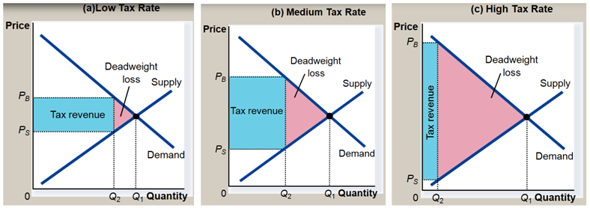
The Deadweight Loss of a Tax Increases with the Square of the Tax Rate
The deadweight loss or excess burden of a dollar of tax revenue measures the dollar value of all the bad decisions made because of taxation beyond the dollar of revenue collected.
Higher tax rates both reduce the quantity of economic activity and increase the average value of the lost economic activity.
This makes the deadweight loss of a tax rate, t, proportional to t².
Dynamic scoring would attempt to measure the size of the revenue rectangle forecasting the reduction in economic activity.
Notes:
The marginal cost of public funds is the sum of a dollar of revenue and the deadweight loss from collecting that dollar of additional revenue. Deadweight loss and the marginal cost of public funds are economic terms that define how leaky the bucket is in the leaky bucket model of taxation.

Slide 9
There is Substantial Uncertainty about the Elasticity of Taxable Income
The elasticity of taxable income measures the responsiveness of the tax base with respect to changes in tax rate.
The economic literature generally agrees that high income taxpayers have the most responsive, highest elasticity of taxable income.
0.5 is a central tendency for the elasticity of taxable income in the literature for the income levels facing tax rate increases under the Administrations’ budgets.
There is considerable uncertainty about the value of the elasticity of taxable income.
Notes:
The marginal cost of public funds is the sum of a dollar of revenue and the deadweight loss from collecting that dollar of additional revenue. Deadweight loss and the marginal cost of public funds are economic terms that define how leaky the bucket is in the leaky bucket model of taxation.
Source: http://www.nber.org/tmp/30757-w15616.pdf
Heim, Bradley. 2009. The Effect of Recent Tax Changes on Taxable Income: Evidence from a New Panel of Tax Returns." Journal of Policy Analysis and Management, 9(1), 147- 163.
http://pubs.aeaweb.org/doi/pdfplus/10.1257/000282805774670004

Slide 10
The Marginal Cost of Public Funds Depends on the Marginal Tax Rate and the Elasticity of Taxable Income
α=1.5
Notes:
The marginal cost of public funds is the sum of a dollar of revenue and the deadweight loss from collecting that dollar of additional revenue. Deadweight loss and the marginal cost of public funds are economic terms that define how leaky the bucket is in the leaky bucket model of taxation.
For a non-technical review of the marginal cost of public funds and the elasticity of taxable income see:
http://www.victoria.ac.nz/sacl/cagtr/twg/publications/5-the-elasticity-of-taxable-income-johncreedy.pdf
Calculations based on equation 5, with alpha equal to 1.5, for the U.S. income distribution parameter for deadweight loss and the marginal cost of public funds equal to one plus the deadweight loss per dollar of revenue.

Slide 11
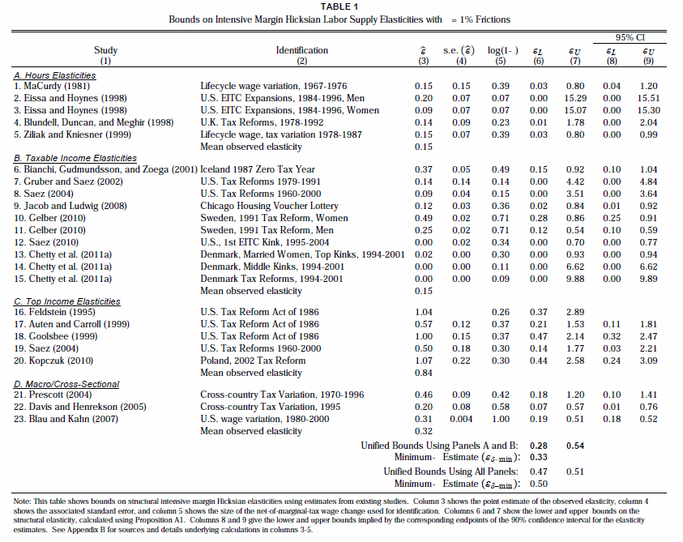
Source: Dr. Raj Chetty, Dept. of Economics Harvard University and NBER
Notes:
Source:
http://www.nber.org/tmp/30757-w15616.pdf

Slide 12
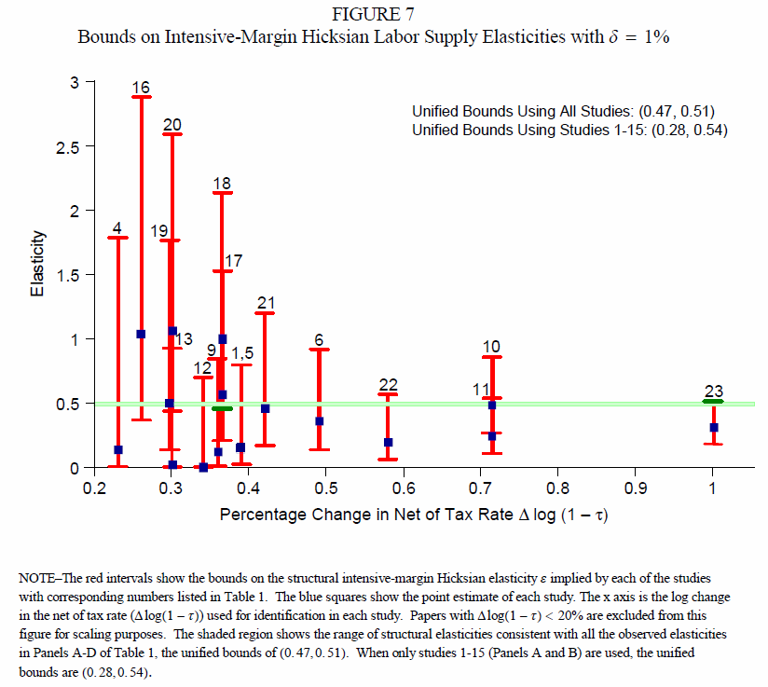
Source: Dr. Raj Chetty, Dept. of Economics Harvard University and NBER
Notes:
Source:
http://www.nber.org/tmp/30757-w15616.pdf

Slide 13
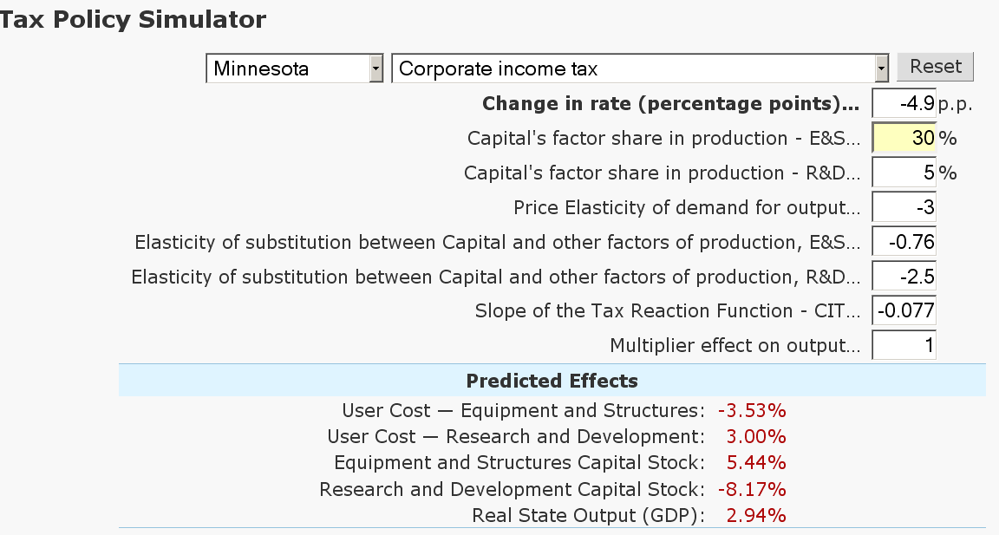
The Size of the Long-Run Economic Gain from Reducing Minnesota Corporate Income Tax from 9.8% to 4.9% Depends on Several Key Elasticities
Source: Chirinko, Robert S. and Daniel J. Wilson “State Business Taxes and Investment: State-by-State Simulations” Federal Reserve Bank of San Francisco Economic Review 2010. (http://www.frbsf.org/publications/economics/review/2010/er13-28.pdf )
Chirinko and Wilson modeling applet. (http://www.frbsf.org/csip/taxapp.php )
Notes:
The Federal Reserve Bank of San Francisco recently published a 2010 research paper, Chirinko, Robert S. and Daniel J. Wilson “State Business Taxes and Investment: State-by-State Simulations” Federal Reserve Bank of San Francisco Economic Review 2010. (http://www.frbsf.org/publications/economics/review/2010/er13-28.pdf )
This study also has an internet modeling applet (http://www.frbsf.org/csip/taxapp.php ), that can be use to simulate the effects of certain changes in state business tax policies, including a change in the state corporate income tax rate, on state output adjusted for inflation. This is an important research paper for policy makers. Intellectually, it is based on the well accepted modeling of how change in the user cost of capital affect the amount of investment in a state’s capital stock leading to changes in real state product. This is a vastly superior method to REMI modeling, which has many defects. This paper is consistent with the best tradition of explicit stating the model and important variables. In contrast, REMI models are a “black box” in which the equations of the modeling process are hidden from the review of outside economists.

Slide 14
Static Revenue-Neutral Tax Reform Generally Increases Tax Revenues
“Tax Reform intended to be revenue neutral is likely to increase tax revenues. Any reduction in the excess burden of the tax system is likely to increase government revenues because the marginal political cost of tax increases is reduced. Evidence from the 1986 tax reform in the United States and the adoption of the value-added tax in many European counties, where the reforms were claimed to be revenue neutral, is consistent with the hypothesis that ‘revenue neutral’ tax reform generates more government revenue.”
(Holcombe and Mills, Public Finance Revenue, 1994)
Notes:
Randall Holcombe and Jeffrey A. Mills. "Is Revenue-Neutral Tax Reform Revenue Neutral?“ Public Finance Quarterly 22, No. 1 (January 1994), pp. 65-85.

Slide 15
Budgets Always Involve Tradeoffs
There are few things wholly evil or wholly good. Almost every thing, especially of government policy, is an inseparable compound of the two; so that our best judgment of the preponderance between them is continually demanded.
- Abraham Lincoln, 1848
A central tradeoff in public budgeting is between the value of another dollar of public expenditures and that marginal cost of public funds to raise that dollar of public expenditures.
Information about the combined effective marginal tax rates facing taxpayers, the square of those tax rates, and the marginal cost of public funds would be helpful to policymakers and the public for policy evaluation.
Notes:
Source: http://www.thelincolnlog.org/view/1848/6/20

